Slide 1

Seismicity of Iraq
Seismological Lab of University of Basrah
(SLUB)
Najah Abd
University of Baghdad
Wathiq Abdulanby
University of Basrah

Slide 2
Earthquakes in Iraq

Slide 3
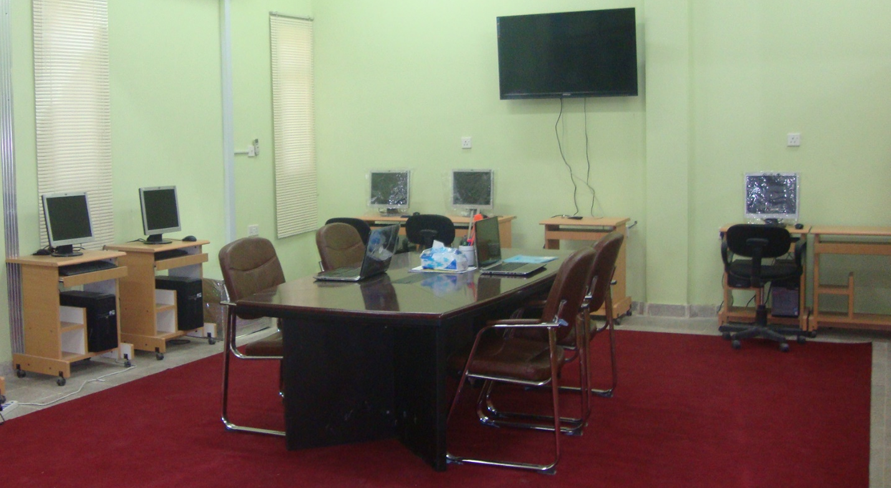
Seismological Lab of University of Basra (SLUB)
The lab was established in October, 2014 at Department of Geology, College of Science, University of Basra.
The staff consists of four researchers from University of Basra, and two researchers from University of Baghdad and Thi Qar.

Slide 4
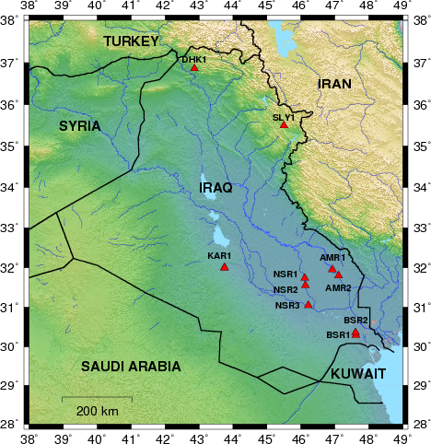
Instruments
Broadband Stations
No. | Station Name | Latitude (degrees) | Longitude (degrees) | Elevation (meters)
1 | BSR1 | 30.360945 | 47.062210 | 61.00
2 | BSR2 | 30.29274 | 47.61912 | 16.00
3 | NSR1 | 31.741632 | 46.115075 | 12.192
4 | NSR2 | 31.554995 | 46.137378 | 9.144
5 | NSR3 | 31.051385 | 46.219893 | 6.096
6 | AMR1 | 31.959033 | 46.928617 | 9.00
7 | AMR2 | 31.989900 | 47.190200 | 9.00
8 | KAR1 | 32.000000 | 44.000000 | ??
9 | SLY1 | 35.5784 | 45.3667 | 756
10 | DHK1 | 36.8606 | 42.8665 | 766

Slide 5
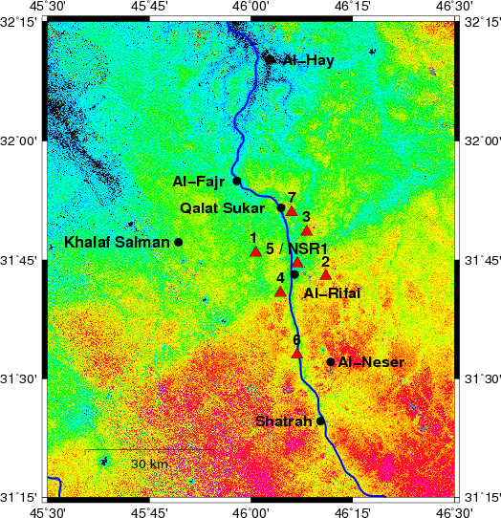
Instruments
Short period
Station Names | Lat. | Log.
HFN1 | 31.765201 | 46.011902
HFN2 | 31.715767 | 46.184351
HFN3 | 31.808941 | 46.137377
HFN4 | 31.680788 | 46.072072
HFN5 | 31.742418 | 46.114313
HFN6 | 31.550409 | 46.113338
HFN7 | 31.849791 | 46.099810

Slide 6
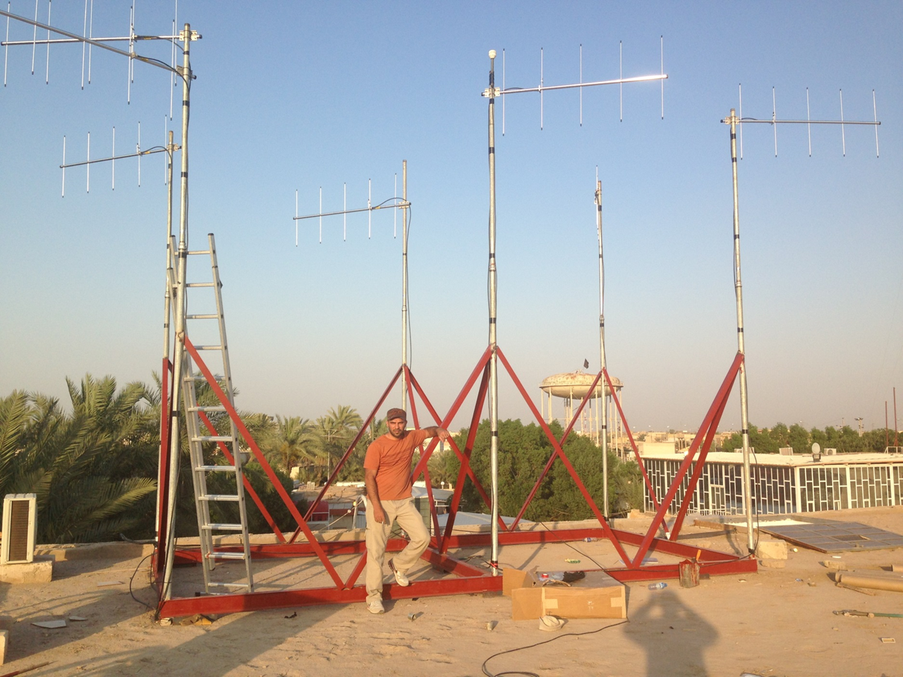
Array installation

Slide 7
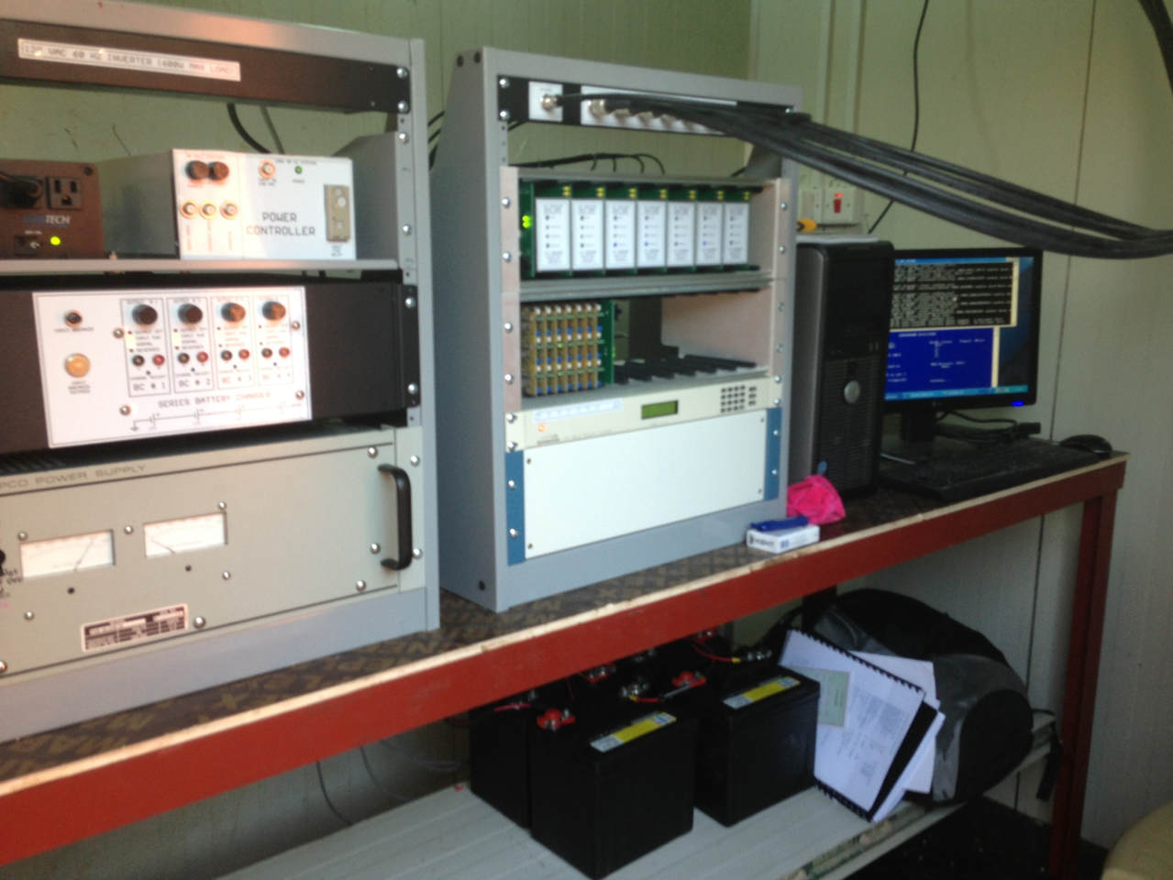
Array installation

Slide 8
Fund and Support
We have been funded by University of Arkansas at Little Rock (UALR) and Lawrence Livermore National Laboratories (LLNL).
In 2014 a seven-element high-frequency three-component array was installed in Al-Rifai area.
Other broadband seismic stations were installed in Basra, Amarah, Nasiria, Karbala, Sulaymaniyah, and Duhok cites.
These stations were installed and hosted by University of Basrah, Thi-Qar, Duhok, and Sulaymaniyah .

Slide 9
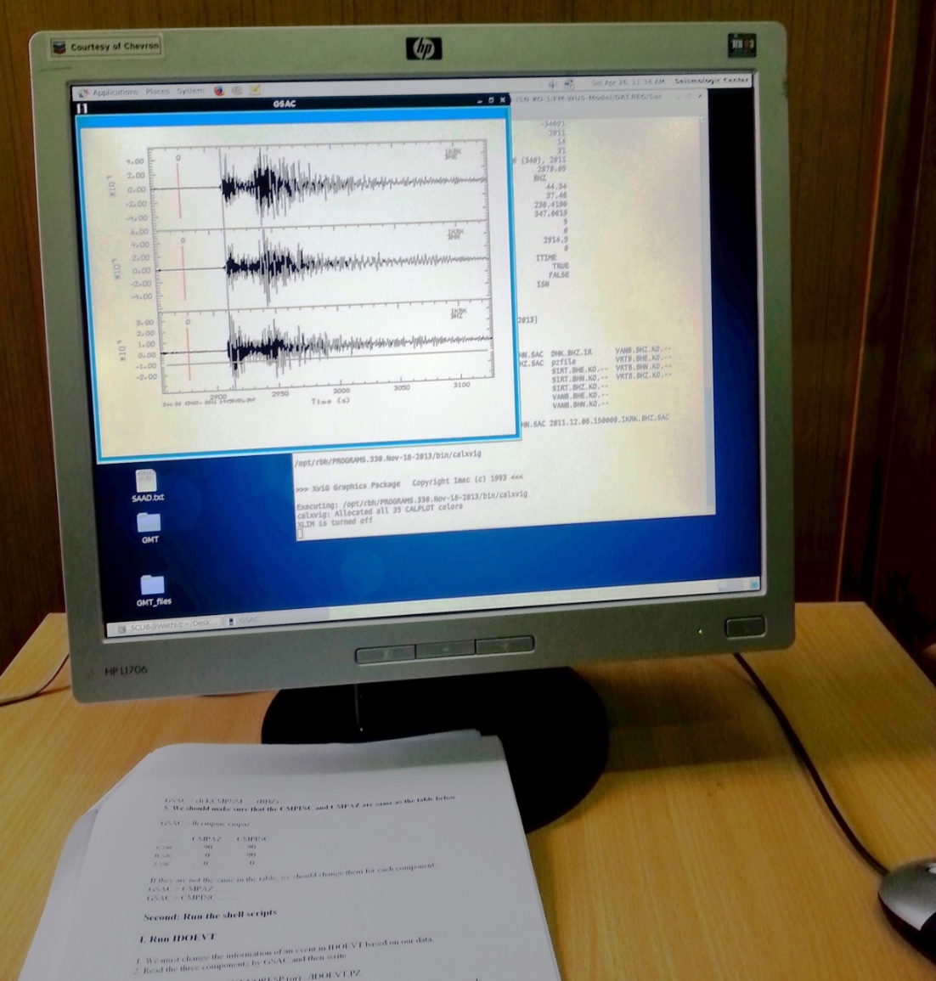
Software
Computer Programs In Seismology (CPS)

Slide 10
Seismological Analyses
Location, depth, and magnitude of earthquakes
Crustal Structure from Joint Inversion of P-wave Receiver Functions and Dispersion Curves
Crustal Structure from Cross-Correlation of Ambient Noise
Focal Mechanism Solutions
Seismic Hazard Map and Building Code
Induced Seismicity

Slide 11
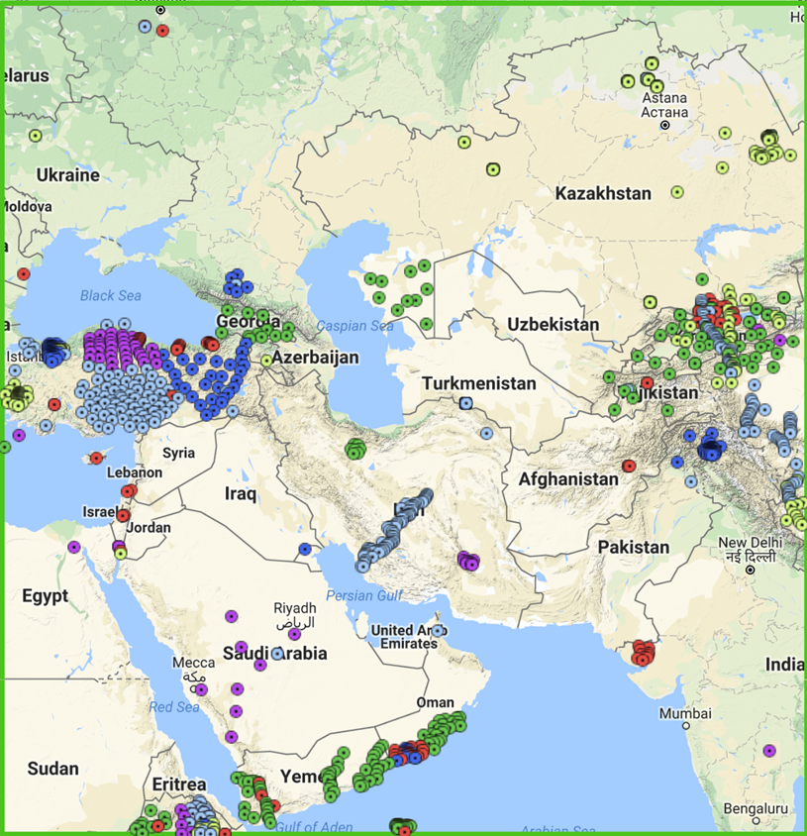
We are planning to shear our broadband data within the FDSN framework in order to full the gap in the map.

Slide 12
Thank You!
Questions?

